Slide 1

Platform Configuration Database
Insyde Software March 2021

Slide 2
Copyright 2021 Insyde Software Corp., All Rights Reserved.
No part of this publication may be reproduced, transmitted, transcribed, stored in a retrieval system, or translated into any language or computer language, in any form, or by any means, electronic, mechanical, magnetic, optical, chemical, manual or otherwise, without the prior written permission of Insyde Software Corp.
Disclaimer
Insyde Software Corp. (“Insyde”), provides this document and the programs "as is" without warranty of any kind, either expressed or implied, including, but not limited to, the implied warranties of merchantability or fitness for a particular purpose.
This document may contain technical inaccuracies or typographical errors. Changes are periodically made to the information herein; these changes will be incorporated in future revisions of this document. Insyde is under no obligation to notify any person of the changes. Some code names featured in this document are used to identify products that are in development and not yet publicly announced for release. Insyde is not obligated for its accuracy or completeness.
This document may contain third party’s information, features, schedules, code names, and product names, which are based on Insyde’s interpretation available as of the creation of this document and may be changed from time to time. Neither Insyde nor the third party is obligated to notify such change. If you are interested in third party’s information, you may contact the local third party sales office or the local distributor to obtain the latest specifications. All the intellectual property right of any third party information remains to its owner or steward.

Slide 3
Agenda
Goals & Target Audience
Overview
How to Add New PCD
How to Use PCD
How to Change PCD in Build Time
PCD Deep Dive
Others
Internal Use

Slide 4
Goal & Target Audience

Slide 5
Goal & Target Audience
Target Audience:
BIOS developers who use InsydeH2O 5.x (EDK II) to create their firmware products.
Goals:
Understand the concept of EDK II PCD.
Know how to create a declaration for a new PCD.
Know how to use PCD in module.
Know how to change PCD value in build time.
Requirements:
InsydeH2O 5.x source code

Slide 6
Overview

Slide 7
Overview EDK2 Platform Configuration Database (PCD)
Platform Configuration Database (PCD)
Uniform configuration interface for module writers
Platform configuration can be set both in build time and runtime with same interface (Pcd Get & Set functions)

Slide 8
Overview Goal
PCD entries are used for module “parameterization”.
Benefits:
Reduce the need to edit source code
No searching for “magic” #define statements
Maximize module reuse across platforms
APIs for access to PCD entries
The PCD is generated by the build. It contains PCD entries specified by:
DEC: declarations of PCD entries
INF: which PCDs are referenced
DSC: value and access method
FDF: flash layout related values

Slide 9
Overview PCD Types
FeatureFlag
Replaces a switch MACRO to enable or disable a feature (TRUE or FALSE)
FixedAtBuild
Replaces a macro that produced a customizable value
Value of this PCD type is determined at build time and is stored in the code section of a module’s PE image
PatchableInModule
Value is stored in the data section, rather than the code section, of the module’s PE image.
Dynamic/DynamicEx
Value is assigned by one module and is accessed by other modules in execution time

Slide 10
Overview
The PCD is generated by the build process parsing the build description files that define and specify PCD entries
Defines list of PCD tokens that modules can use.
Defines the PCD entries that will exist under the GUID for that package, the PCD restriction, valid types for the PCD, and a default value for the PCD.
Defines usage of PCD tokens by the module
Defines what PCD entries are being used within the module, the PCD restriction (or DYNAMIC for none), and a default value for the PCD within this module only.
Platform level file which describes the contents of the build for a specific platform.
PCD entries are assigned values and types for the platform build. Cannot conflict with established restrictions.
.DEC
.INF
.DSC
The DEC file is part of a package. Any package may define PCD entries. Any module that depends on a package may use the PCD entries defined in that packages' DEC file
The INF file also carries descriptive text for a given PCD entry
In most cases, PCD entries do not have SKU enabled and have a single value associated with them. However, if a PCD entry is SKU the PCD entry may have multiple values.
Source: Intel®

Slide 11
Overview Syntax
DEC
PCD defined in the DEC file from any package
[Guids.common]
PcdTokenSpaceGuidName={ 0xXXXXXXXX, 0xXXXX, 0xXXXX, { 0xXX, . . .}}
. . .
[Pcds...]
PcdTokenSpaceGuidName.PcdTokenName|Value[|DatumType[|MaxSize]]|Token
DatumType: BOOLEAN/UINT8/UINT16/UINT32/UINT64/*VOID
PCD usage listed in INF file for module
[…Pcd…]
PcdTokenSpaceGuidName.PcdTokenName|[Value]
Value of PCD set in Platform DSC
[Pcds...]
PcdTokenSpaceGuidName.PcdTokenName|Value[|DatumType[|MaximumDatumSize]]
INF
DSC

Slide 12
Overview Example
DEC
Defined in Nt32Pkg Package .DEC
[PcdsDynamic.common]
gEfiNt32PkgTokenSpaceGuid.PcdWinNtGop|L"UGA Window 1!UGA Window 2"|VOID*|0x0000100d
Module INF lists which PCDs get accessed
Nt32Pkg\WinNtBusDriverDxe\WinNtBusDriverDxe.inf
[Pcd]
gEfiNt32PkgTokenSpaceGuid.PcdWinNtGop
Value to use in Nt32Pkg Package .DSC
[PcdsDynamicDefault.common.DEFAULT] gEfiNt32PkgTokenSpaceGuid.PcdWinNtGop|L"My EDK II Window 1!My EDK II Window 2"|VOID*|50
Referenced in the code
Nt32Pkg\WinNtBusDriverDxe\WinNtBusDriver.c
NT_PCD_ENTRY mPcdEnvironment[] = {
PcdToken(PcdWinNtGop), &gEfiWinNtGopGuid,
INF
DSC
code

Slide 13
Overview PCD Parsing Precedence
A PCD value defined on the command-line using -D PcdName=Value
A PCD value defined in the FDF file SET statements
A PCD value defined positionally in the FDF file
A PCD value defined in the [Components] INF scoping section (DSC)
A PCD value defined in a [Pcds*] architectural section (DSC)
A PCD value defined in a [Pcds*] common architectural section (DSC)
A PCD value defined in an INF
A PCD default value defined in the DEC file that declares the PCD
Recommend that you modify the PCDs value in the .dsc !!

Slide 14
Overview PCD Parsing Precedence
Function Name | Usage
PcdGetXxx()/PcdSetXxxS() | Common Get/Set function for all PCDs type
FeaturePcdGet() | Get function for “FeaturePcd”
FixedPcdGetXxx() | Get function for “FixedPcd”
PatchPcdGetXxx()/PatchPcdSetXxx() | Get/Set function for “PatchPcd”
PcdGetExXxx()/PcdSetExXxxS() | Get/Set function for “DynamicPcd”
Xxx: 8, 16, 32, 64, Ptr, Bool

Slide 15
How to Add New PCD

Slide 16
How to Add New PCD
The format for entries in the PCDs sections is four fields, with a pipe “|” character as the field separator, as shown below:
# Comment
TokenSpaceGuidCname.PcdCname|DefaultValue|DatumType|Token
[PcdsFeatureFlag]
#FeatureFlag PCD is BOOLEAN type, the value is TRUR or FALSE.
PcdTokenSpaceCGuidName.PcdCName|TRUE|BOOLEAN|TokenNumber
PcdTokenSpaceCGuidName.PcdCName|FALSE|BOOLEAN|TokenNumber
[PcdsFeatureFlag]
## If TRUE, the component name protocol will not be installed.
gEfiMdePkgTokenSpaceGuid.PcdComponentNameDisable|FALSE|BOOLEAN|0x0000000d

Slide 17
How to Add New PCD
[PcdsFixedAtBuild]
PcdTokenSpaceCGuidName.PcdName|DefaultValue|DataType|TokenNumber
[PcdsPatchableInModule]
PcdTokenSpaceCGuidName.PcdName|DefaultValue|DataType|TokenNumber
[PcdsDynamicEx]
PcdTokenSpaceCGuidName.PcdName|DefaultValue|DataType|TokenNumber
[PcdsFixedAtBuild, PcdsPatchableInModule, PcdsDynamic, PcdsDynamicEx]
## This value is used to set the base address of pci express hierarchy
gEfiMdePkgTokenSpaceGuid.PcdPciExpressBaseAddress|0xE0000000|UINT64|0x0000000a

Slide 18
How to Add New PCD
SamplePkg/SamplePkg.dec
[PcdsFeatureFlag]
gEfiSamplePkgTokenSpaceGuid.PcdFlag|TRUE|BOOLEAN|0x00000001
[PcdsFixedAtBuild]
gEfiSamplePkgTokenSpaceGuid.PcdFixed|0x12|UINT8|0x00000002
[PcdsPatchableInModule]
gEfiSamplePkgTokenSpaceGuid.PcdPatch|0x1234|UINT16|0x00000003
[PcdsDynamicEx]
gEfiSamplePkgTokenSpaceGuid.PcdSampleDynEx|L”Hello”| VOID* |0x00000005

Slide 19
How to Use PCD

Slide 20
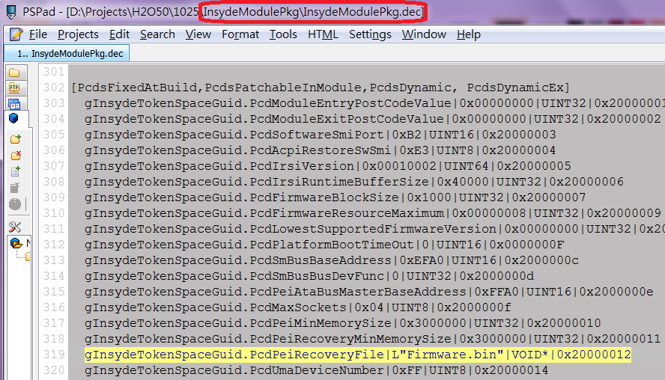
How to Use PCD
Identify where the PCD is declared

Slide 21
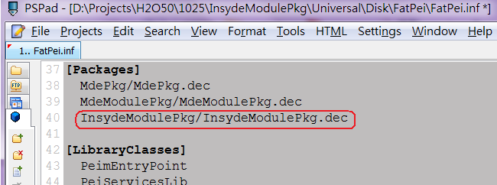
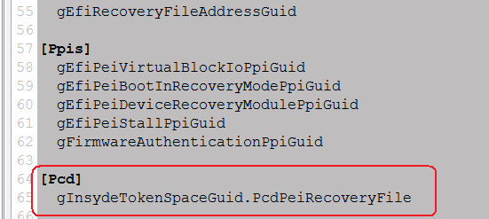
How to Use PCD
Identify where the PCD is declared
Add the package to the INF’s [Packages] section
Add PcdLib to the INF’s [LibraryClasses] section
Add the PCD to the INF’s [Pcd] section

Slide 22
How to Use PCD
Identify where the PCD is declared
Add the package to the INF’s [Packages] section
Add PcdLib to the INF’s [LibraryClasses] section
Add the PCD to the INF’s [Pcd] section
Include PcdLib Library Class header file and use PCD access function in C file

Slide 23
How to Change PCD in Build Time

Slide 24
How to Change PCD in Build Time
$(PROJECT_PKG)/Project.dsc
[PcdsFeatureFlag]
gEfiSamplePkgTokenSpaceGuid.PcdFlag|FALSE
[PcdsFixedAtBuild]
gEfiSamplePkgTokenSpaceGuid.PcdFixed|0x21
[PcdsPatchableInModule]
gEfiSamplePkgTokenSpaceGuid.PcdPatch|0x4321
[PcdsDynamicExDefault]
gEfiSamplePkgTokenSpaceGuid.PcdSampleDynEx|L”Hi”

Slide 25
PCD Deep Dive

Slide 26
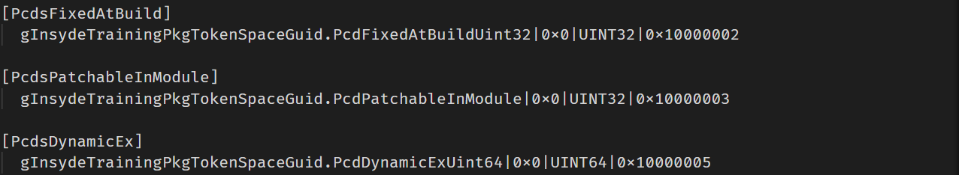
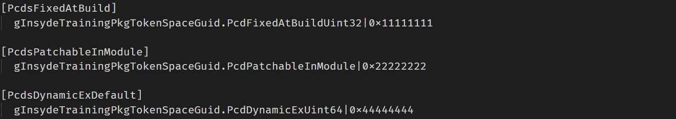
PCD Deep Dive
DEC (PCD Declaration in TestPkg/TestPkg.dec)
DSC (PCD Value Initialization in Nt32Pkg/Nt32Pkg.dsc)

Slide 27
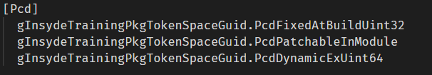
PCD Deep Dive
PcdUtility.inf

Slide 28
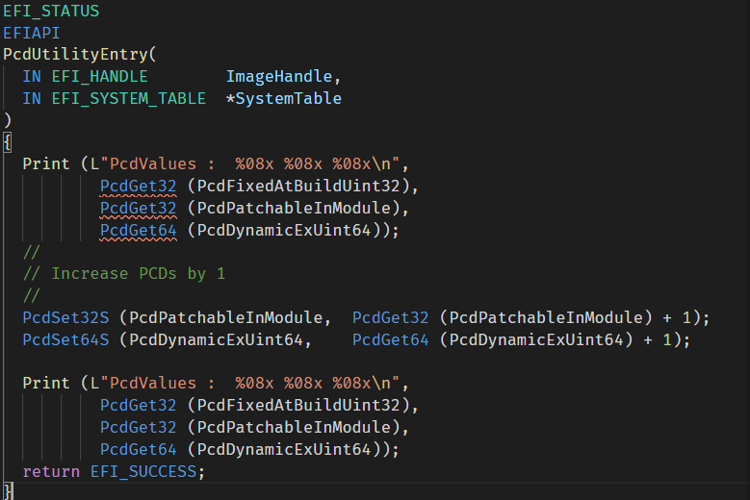
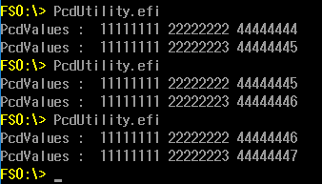
PCD Deep Dive

Slide 29
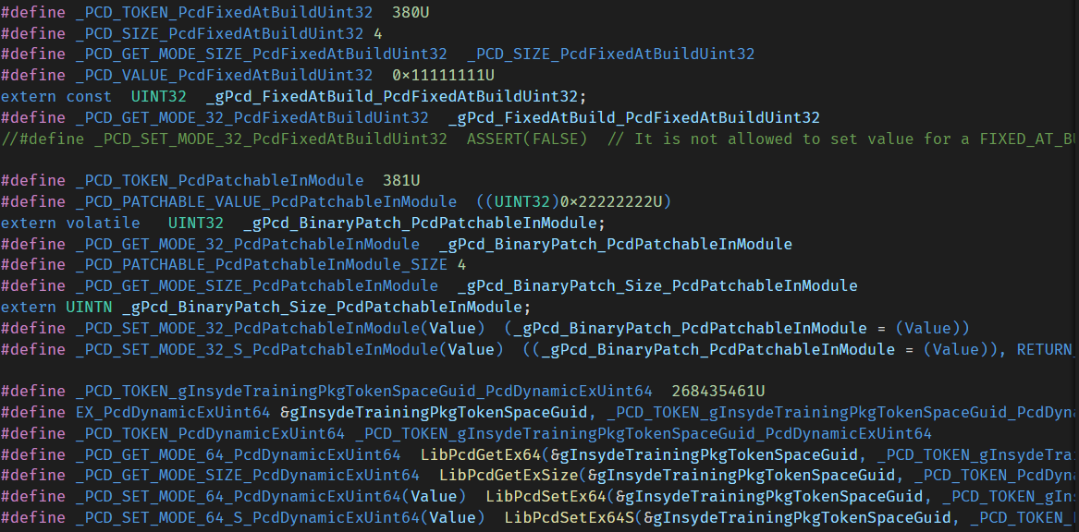
PCD Deep Dive
AutoGen.h of PcdUtility application build output

Slide 30
PCD Deep Dive
AutoGen.c & AutoGen.h of PcdUtility application build output
AutoGen.c
AutoGen.h

Slide 31
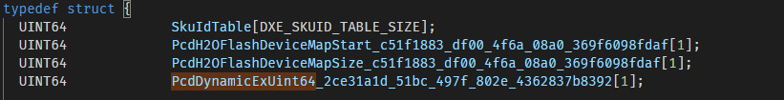
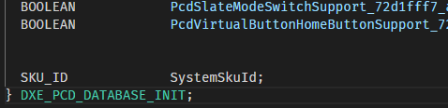
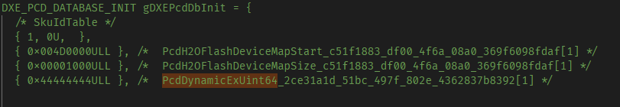
PCD Deep Dive
AutoGen.h & AutoGen.c of PcdSmmDxe driver build output
AutoGen.h
…
AutoGen.c
Build tool GATHERS all the dynamic PCDs used in the modules listed in the [Components]
section of platform package DSC, and creates PCD database in PcdDxe driver
Notes:
Build\NtEmulatorPkg\DEBUG_DEVTLSxVC10\X64\InsydeModulePkg\Universal\PcdSmmDxe\Pcd\DEBUG

Slide 32
Others

Slide 33
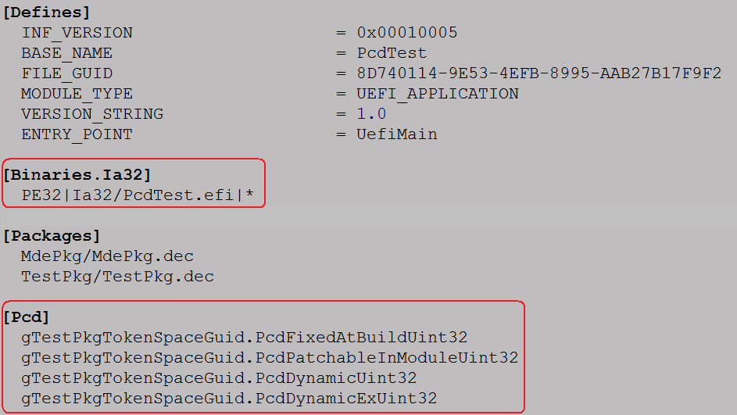
Others Caution on Binary Modules using Dynamic PCDs
INF format drivers with [PCD] section should be used and added to the [Components] section of DSC to ensure dynamic PCDs are generated into PCD database by build tool.
Example
Do not remove it if it
contains dynamic PCDs

Slide 34
Thanks!

